Slide 1
Flight Delay Prediction
W261 - Fall 2020 Project Team 26
Hanyu Dai
Edward Tong
Shishir Agarwal
Praveen Kasireddy
Notes:
Hi good afternoon all, I am Edward. My team is team 26 with team members of Hanyu, Shishir, Praveen. Our target audience for this presentation is the carriers and the project scope is to use Machine Learning infrastructure and technique to predict US airports flights delay in advance, and the main objectives are to minimize the cost incur due to flight delay , and improve customer satisfaction.

Slide 2
Agenda
Introduction of Business Case
Problem Statement and Research Question
Overall Approach
Data Sets Overview
Evaluation Metrics
EDA
Features Engineering
Features Selection
Algorithms Exploration and Implementation
Performance and Scalability
Limitations and Challenge
Conclusion
Notes:
I will start to give some highlight and overview about the business case, problem statement and research question, and then our approach for this project with the overview of the datasets and the evaluation metrics that we adopted for the modelings,
Next will be Shishir go through the EDA and features engineering , follow by Hanyu and Praveen talk about features selection and modeling, and our recommendation and conclusions.

Slide 3
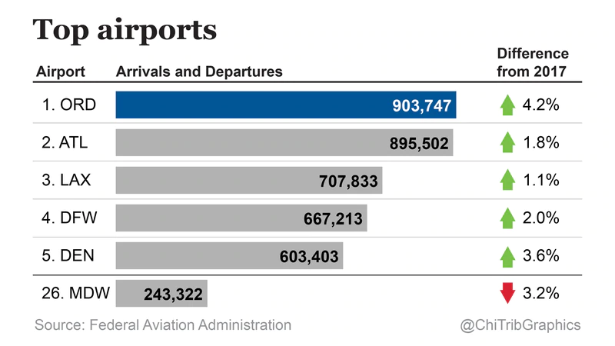
Business Case
Total Cost of Delay in the U.S.
(dollars, billion)
 | 2016 | 2017 | 2018 | 2019
Airlines | 5.6 | 6.4 | 7.7 | 8.3
Passengers | 13.3 | 14.8 | 16.4 | 18.1
Lost Demand | 1.8 | 2.0 | 2.2 | 2.4
Indirect | 3.0 | 3.4 | 3.9 | 4.2
Total | 23.7 | 26.6 | 30.2 | 33.0
https://www.chicagotribune.com/news/breaking/ct-biz-ohare-flight-numbers-20190204-story.html
https://www.faa.gov/data_research/aviation_data_statistics/media/cost_delay_estimates.pdf
Total Cost of Delay
Notes:
Based on FAA information,
on average some of the busier airports handle 1,500 arrivals and 1,500 departures on average per day.
Flights delayed are estimated to have cost the airlines several billion dollars additional expense. Delays also drive the need for extra gates and ground personnel and impose costs on airline customers in the form of lost productivity, wages and goodwill.
And the FAA estimated the annual related costs of delays in 2019 is $33 billion,
(direct cost to airlines and passengers, lost demand, and indirect costs)
Additional Costs
Delayed aircraft are estimated to have cost the airlines several billion dollars in additional expense. Delays also drive the need for extra gates and ground personnel and impose costs on airline customers (including shippers) in the form of lost productivity, wages and goodwill.
Assuming $47 per hour* as the average value of a passenger’s time, flight delays are estimated to have cost air travelers billions of dollars. FAA/Nextor estimated the annual costs of delays (direct cost to airlines and passengers, lost demand, and indirect costs) in 2018 to be $28 billion.

Slide 4

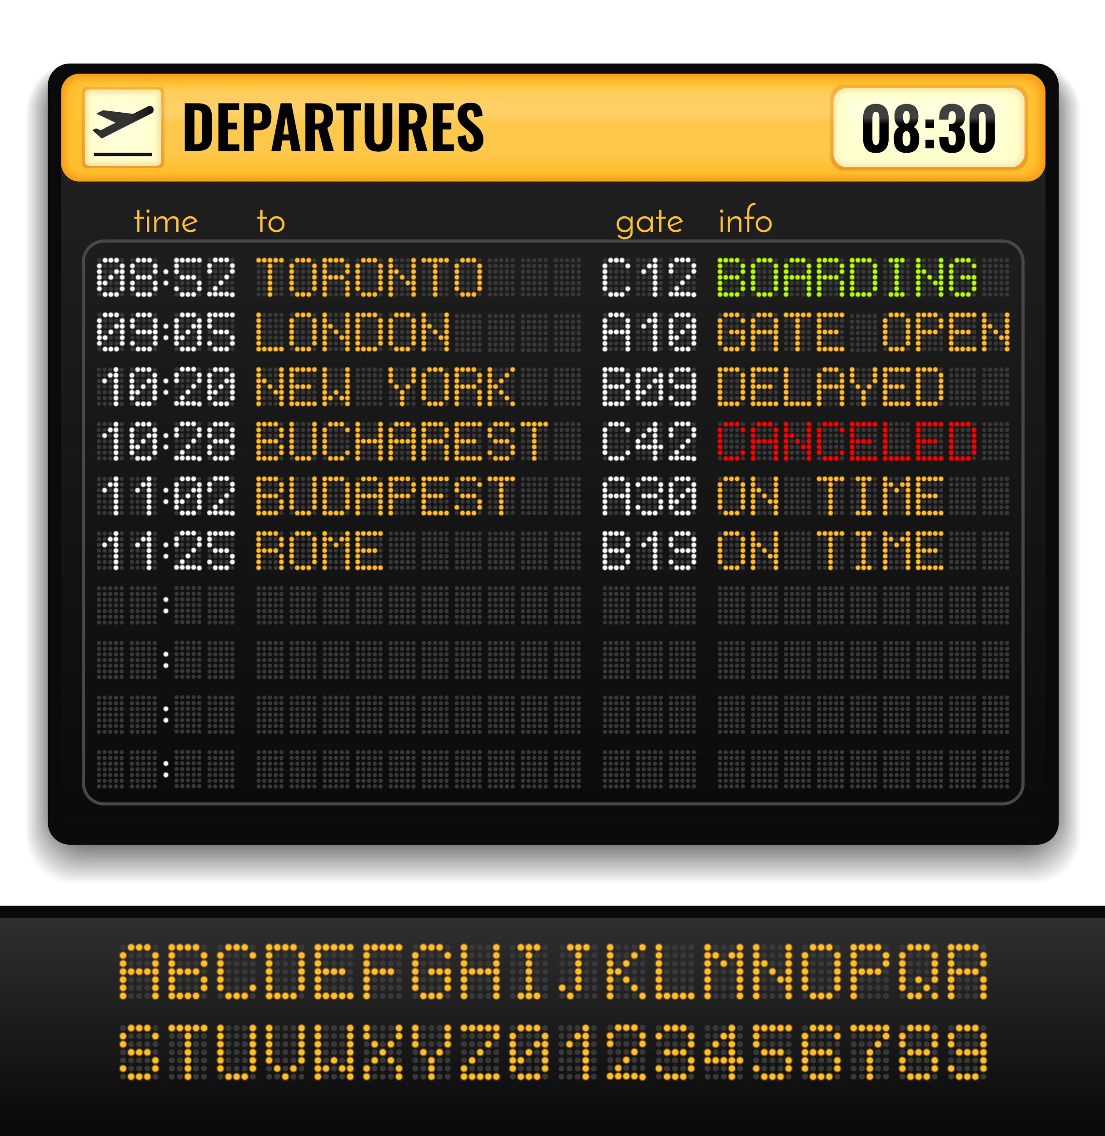
Problem Statement & Research Question
S: What are the Problems caused by Flight Delay?
https://www.transportation.gov/briefing-room/dot8717
Q : Predicting “Departure” Flight
Delay or NO Delay
Definitions:
Delay
>= 15 minute w.r.t to the planned time of departure (CRS).
Prediction
“Two hours” ahead of CRS departure time
https://www.airlines.org/dataset/per-minute-cost-of-delays-to-u-s-airlines/#
Notes:
That leads to Our Problems statement for flight delay,
flight schedule change leading to passenger inconvenience, and huge economic losses to ALL parties.
And Our research question is predicting flight delay to Optimize operations, sustain and improve customer satisfaction
And to frame this project, our scope is focus in predicting departure delay, and also define delayed flight is when departure flight is over 15-minutes against the CRS schedule and our target is to predict flight delay with weather conditions 2-hours ahead of the departure time.
How did we manage the project ?

Slide 5
Overall Approach - Machine Learning Phases
EDA and Preprocessing
Feature Engineering
Algorithms
Implementation
Hyperparameter Tuning
Ensemble
Analysis and Imputation of Missing Values
Transforming and Scaling Features
Numerical
Categorical
Logistics
Regression
Adjusting Hyperparameters
Selecting best model based on prediction metrics
“Precision”
&
False Positive
Shortlist of most important features
Decision Tree
Derived Variables
Understand and Visualize Data
Histogram, Heatmaps, Correlation Matrix, Scatter Plots
Ensemble
Random Forest
Gradient Boosting
Notes:
We have defined a project plan with tasks that then follow the approach as show, it consists of 5 general machine learning phases to analysis the data, train and test our models

Slide 6
Data Sets - Overview
Raw (before any processing)
 | Period | No. of Features | No. of Records
Flights | 2015-2019 | 109 | 31,746,841
Weather | 2015-2019 | 177 | 630,904,436
Stations | NA | 11 | 29,771
Other Dataset used:
Airports data from openflights.org for time zone transformation
2. Modeling (after processing)
 | Period | No. Of Features | No. Of Records
Training | 2015-2018 | 53 | 16,528,705
Test | 2019 | 53 | 5,082,228
Notes:
We explore the 4 raw datasets and then pre- processed them into training and test subsets where our training data size is about half of the flights raw data and testing data is about one third of the training data size.

Slide 7
Model Evaluation Metrics
Classifications :
"Delayed"
positive class
"No Delayed "
negative class
Year | No Delayed | Delayed
2015 | 4,675,372 | 1,057,554
2016 | 4,600,659 | 953,543
2017 | 4,580,433 | 1,013,845
2018 | 5,789,777 | 1,306,435
Accuracy : (TP +TN) / (TP + TN + FP + FN)
Precision: (TP) / (TP + FP)
Recall: (TP) / (TP + FN)
?
Notes:
Before we start to tackle the problem , we first defined the classification of flight delay , positive class as a DELAYED flight and negative as a NO DELAYED, we also look into no. of metrics for evaluating the models from business perspective.
As the class imbalanced issue, there is a significant disparity between the number of positive and negative labels , so accuracy may be a misleading metric for this case
Instead , we look at Precision and Recall for performance evaluation , and what does it mean from business perspective , Let’s use the confusion matrix to elaborate more
To fully evaluate the effectiveness of a model, you must examine both precision and recall. Unfortunately, precision and recall are often in tension. That is, improving precision typically reduces recall and vice versa.
what does it mean from business perspective
Precision
When model said "positive" class, was it right?
Intuition: Did the model predict "delay" too often?
Recall
Out of all the possible positives, how many did the model correctly identify?
Intuition: Did it miss any delay ?

Slide 8
Model Evaluation Metrics - Confusion Matrix
Predictions
Flights | Delay | No Delay
Delay | True Positive , TP Reality: DELAY Prediction:DELAY Outcome: EVERYONE is Fine Eg. TP = 1 | False Negative , FN Reality: DELAY Prediction: NO DELAY Outcome: EVERYONE are Annoyed E.g FN =8
No Delay | False Positive, FP Reality: NO DELAY Prediction: DELAY Outcome: EVERYONE is UNHAPPY Eg. FP = 1 | True Negative, TN Reality: NO DELAY Prediction: NO DELAY Outcome: EVERYONE is FINE E.g TN = 90
Actual
Notes:
From the 2x 2 matrix, we think
TP and TN are a good indicator for all, they can plan ahead and minimize cost, inconvenience and economic impacts
But both FP and FN are bad as it will incur cost and impacts, so it should be avoided.
In particular , we believe FP is worse than FN, as it will incur unnecessary cost and pre arrangement to handle the prediction in delay
So our target is to achieve a model with low FP and FN
Next , I will pass to Shishir to discuss the data processing and EDA. Thank you.
Example: supplement:
ACCURACY = (TP+TN) /(TP+TN+FP+FN) = (1+90)/(1+90+1+8)= 0.91
100 delay/no delay,, 91 are NO DELAY (90 TNs and 1 FP) and 9 are DELAYED (1 TP and 8 FNs).
Of the 91 NO DELAY , the model correctly identifies 90 NO DELAY. That's good. However, of the 9 DELAYED,, the model only correctly identifies 1 as DELAYED —a terrible outcome, as 8 out of 9 DELAYED is undetected

Slide 9
Weather EDA - Forward Filling Null Data
Station | Date | Timestamp | WND_DIRECTION
72219013874 | 2015-01-01 | 2015-01-01T00:52:00.000+0000 | 330
72219013874 | 2015-01-01 | 2015-01-01T01:52:00.000+0000 | 310
72219013874 | 2015-01-01 | 2015-01-01T02:52:00.000+0000 | null
Before
Code:
window = Window.partitionBy('STATION','date').orderBy('Timestamp').rowsBetween(-250, 0)
filled_column = last(weather_data['WND_Direction'], ignorenulls=True).over(window)
Station | Date | Timestamp | WND_DIRECTION
72219013874 | 2015-01-01 | 2015-01-01T00:52:00.000+0000 | 330
72219013874 | 2015-01-01 | 2015-01-01T01:52:00.000+0000 | 310
72219013874 | 2015-01-01 | 2015-01-01T02:52:00.000+0000 | 310
After
Notes:
Thanks Edward. Because we are dealing with large dataset, we chose an approach that is performant, scalable and efficient.
Our analysis showed the airlines data and station data were both good with very few duplicates and missing values. We were able to use this data without much pre-processing.
However weather data was a different story. Thus, most of our preprocessing was focused on the weather data. I will share few techniques we used for the weather data.
One technique we used for weather data is to impute a null value based on the earlier value within 1 day time window. Thus, we partitioned the data based on the station and the date and within a specific date we looked at all the weather values and forward fill the null value with the closest previous value. This approximation allowed us to keep many of the rows with null value intact.

Slide 10
Weather EDA - Resolving Multiple Readings
Station | Date | Timestamp | WND_SPEED
72219013874 | 2015-01-02 | 2015-01-02T19:22:00.000+0000 | 36
72219013874 | 2015-01-02 | 2015-01-02T19:47:00.000+0000 | 21
72219013874 | 2015-01-02 | 2015-01-02T19:52:00.000+0000 | 31
Before
Code:
weather_data = weather_data.withColumn("DATE", f.date_trunc("hour", "DATE"))
weather_data = weather_data.groupBy("STATION", "DATE").agg(f.max("WND_SPEED"))
Station | Date | Timestamp | WND_SPEED
72219013874 | 2015-01-02 | 2015-01-02T19:22:00.000+0000 | 36
72219013874 | 2015-01-02 | 2015-01-02T19:47:00.000+0000 | 36
72219013874 | 2015-01-02 | 2015-01-02T19:52:00.000+0000 | 36
After
Notes:
One other decision we made is to decide on how granular do we want our weather data to be.
Do we want our weather data to be in seconds, minutes, or hous.
We decided to use hourly weather data for our analysis.
When we use the hourly weather data we found ourselves with multiple readings within the hour. We chose the maximum of the readings within an hour.
This allowed us to limit the amount of weather data when we did the join with the airlines data.
This was an important step in making joining of weather data with airline data scalable

Slide 11
Joining Data
Code :
airlines.join(stations, (stations.call==airlines.ORIGIN) & (stations.state==airlines.ORIGIN_STATE_ABR), 'inner')
Airlines
Station
Airline_Station
Airline_Station
Weather
Airline_Station_Weather
Code:
sqlContext.sql("SELECT * FROM airlines INNER JOIN weather ON airlines.station= weather.station AND airlines.FL_TIMESTAMP_EARLY = weather.DATE")
Notes:
With the above techniques in place we were able to use two different styles of join. Simple join function for dataframe as well as Spark SQL to join the data. We did not see much performance difference between the two.
We first join the airlines data with station data by using call # and the state abr.. With this join we were able to assign a station number to each airlines data. That is assign station # to source and destination.
Next we joined the above data with weather information by using station# and weather reading for each flight departure time.
We were able to achieve these joins without too much data loss or data explosion in a scalable manner because of our pre-processing techniques.

Slide 12
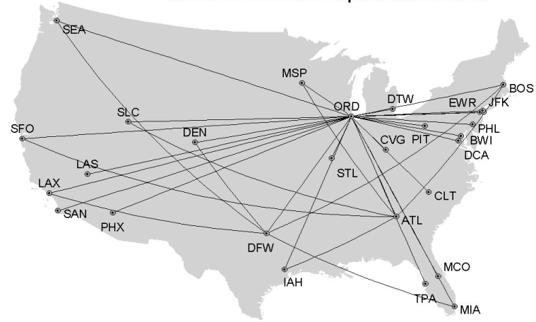
Feature Engineering via Pagerank
Airport | Pagerank
ORD | 14.276905975254800
ATL | 13.212343130314500
MSP | 8.033267082044770
IAH | 7.423410445540550
DTW | 7.199458684764240
CLT | 7.167862270451910
SLC | 6.195332319456120
SFO | 6.166775954573200
EWR | 5.836649337579180
PHX | 5.440932366785200
LAX | 5.368049462519130
# create Edge
E = DF_train.groupBy(["ORIGIN","DEST","DEP_DELAY"]).count().withColumnRenamed("ORIGIN","src").withColumnRenamed("DEST","dst").withColumnRenamed("count","weight")
# create Vertics
V = DF_train.select(["DEST"]).distinct().withColumnRenamed("DEST", "id")
# create graph with E and G
airlinesGraph = GraphFrame(V, E)
ranks = airlinesGraph.pageRank(resetProbability=0.15, maxIter=5)
Notes:
In addition to spending time on preprocessing we also spent time on feature engineering which is to enrich the data further with additional features. We feel this was a very important part of the project and it helped us achieve good results.
One of the feature engineering we did is to create a graph out of the airline data. We considered each airport to be a vertex within a graph and we considered each edge to be a flight route between source and destination. After creating a graph we ran the page rank algorithm on the graph to calculate the pagerank of the airport. We used the Spark Graph Frame to achieve this. We then enrich the source airport with pagerank for origin and pagerank for dest.
We will now have Hanyu walk us through other aspects of feature engineering.

Slide 13

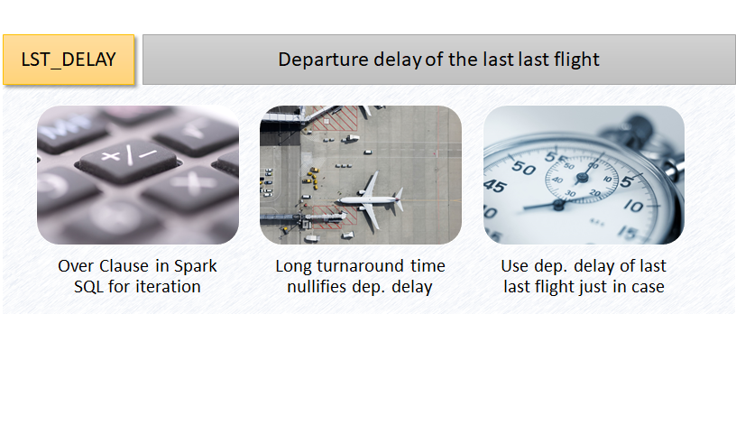
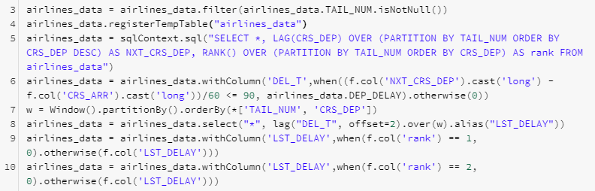
Feature Engineering
Notes:
Use window function (over clause) in Spark SQL to iterate over tail number and find next departure time for each flight
If the plane stays for more than 90 min in the airport, we assume that delay from last flight no longer affect departure time of next flight
Since we predict departure delay 2 hrs beforehand, we use delay of last last flight (sometimes we can not have delay of last flight so early).

Slide 14

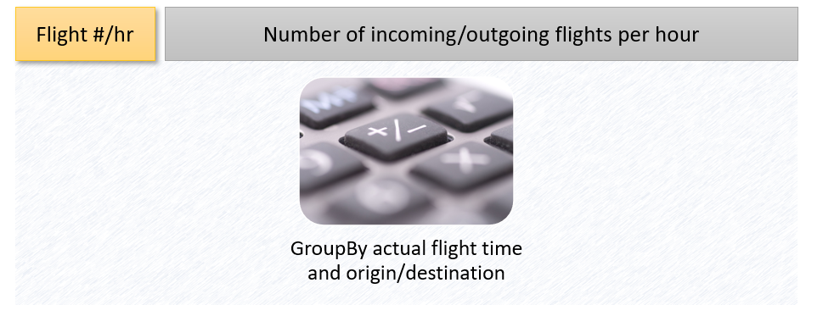
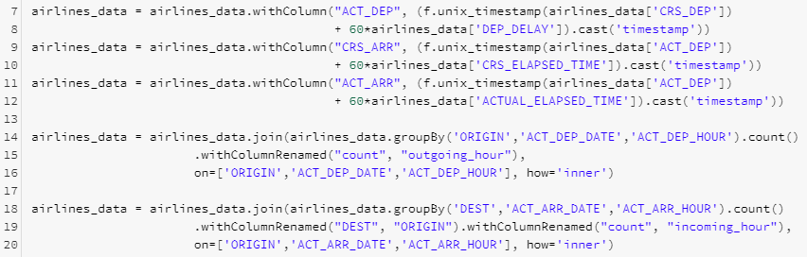
Feature Engineering

Slide 15
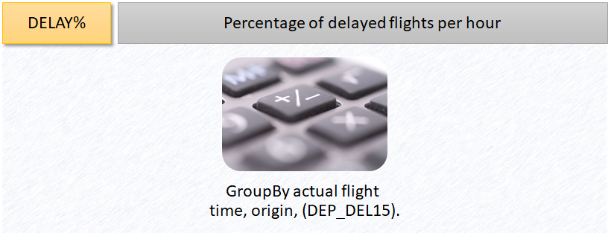
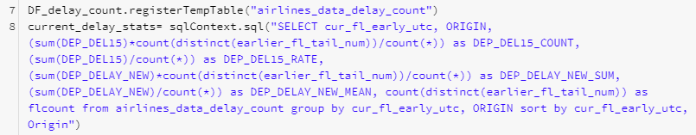
Feature Engineering
Notes:
Use window function (over clause) in Spark SQL to iterate over tail number and find next departure time for each flight
If the plane stays for more than 90 min in the airport, we assume that delay from last flight no longer affect departure time of next flight
Since we predict departure delay 2 hrs beforehand, we use delay of last last flight (sometimes we can not have delay of last flight so early).

Slide 16
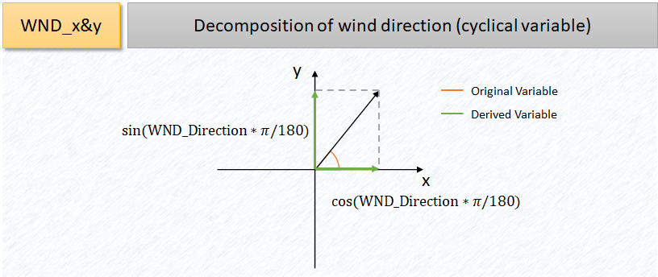
Feature Engineering

Slide 17
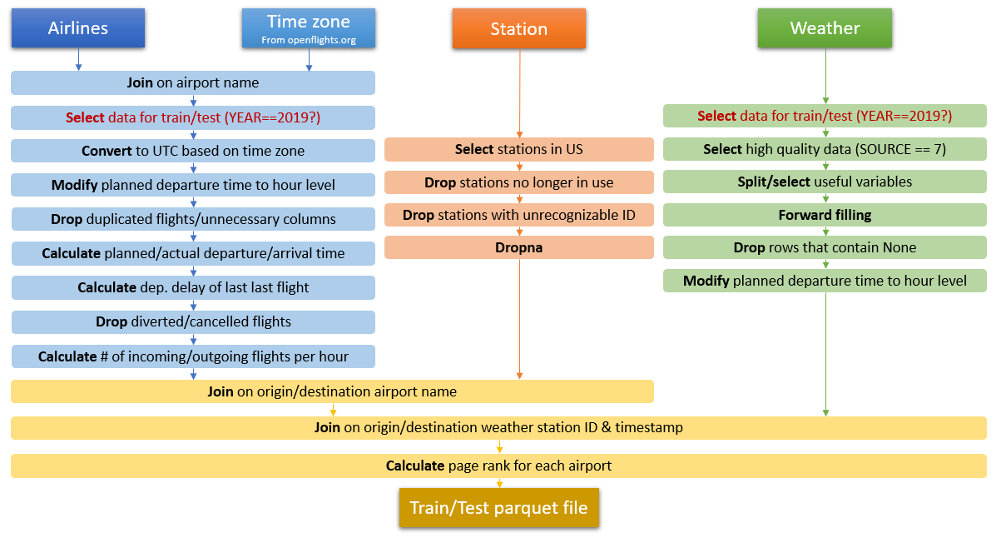
Pipeline

Slide 18
Features Selection
Objective: Limit the input features to the important once.
Techniques Explored:
RandomForest featureImportance
Chi-square test
Lasso
Feature | Feature Importance
LST_DELAY | 0.546916
HOUR_OF_DAY | 0.318057
OP_CARRIER_WN | 0.025992
Outgoing_hour | 0.022456
Tail_freq | 0.020698
MA1_Altimeter_origin | 0.018813
WND_Speed_origin | 0.012826
MA1_Altimeter_dest | 0.011495
Pagerank_DEST | 0.011383
TMP_Air_origin | 0.011366
Rf = RandomForestClassifier(labelCol="DEP_DEL15", featuresCol="features")
RfModel = Rf.fit(DF_train)
print(RfModel.featureImportances)
Notes:
As the datasets have over 100 features, we explore multiple options for feature selection like RandomForest featureimportance, Chisquare test, Lasso regression. When we used RandomForest featureImportance, we can see features like LST_DELAY, Hour of the dat and SouthWest carrier etc came with high importance. We see mix of derived and given features in the top 10 important features.

Slide 19
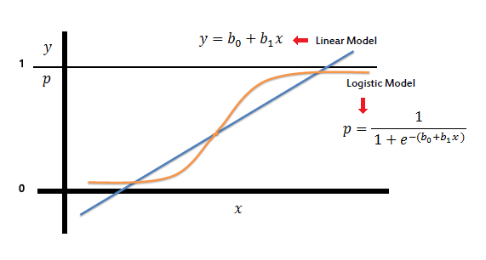
Algorithms - Logistic & Linear Regression
Base Models
Logistic Regression
Dependent Variable: DEP_DEL15
Linear Regression
Dependent Variable: DEP_DELAY
Input Variables Selection:
Feature Importance
PCA
Notes:
After the feature engineering and feature selection, we started with base models. We tried Logistic Regression for predicting DEP_DEL15 and we also explored Linear Regression to predict the delay time. Logistic Regression, we observed lower precision, recall and also Linear Regression R2 value was low and we moved on to trying advanced models.

Slide 20
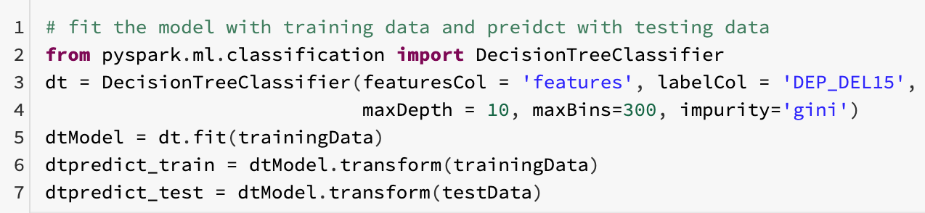
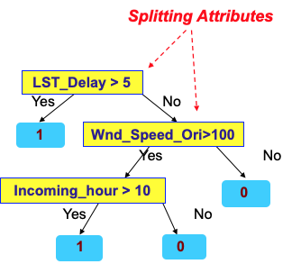
Algorithms - Decision Tree
Non-parametric supervised learning method
Output: DEP_DEL15
Features: ['LST_DELAY','outgoing','incoming','’MONTH','DAY_OF_WEEK' ..]
 | Training Data | Test Data
Precision | 0.706 | 0.709
Recall | 0.178 | 0.154
F1 Score | 0.284 | 0.253
Notes:
In the advanced models, we started with Decision Trees and we built the model with features from airlines, weather data sets including the derived features. After trying various features, the final model we have is with 33 features with maxdepth of 10, maxBins of 300 etc.
We saw higher precision with DecissionTree but recall is still lower. Prediction performance on testData is on par with trainingData.

Slide 21
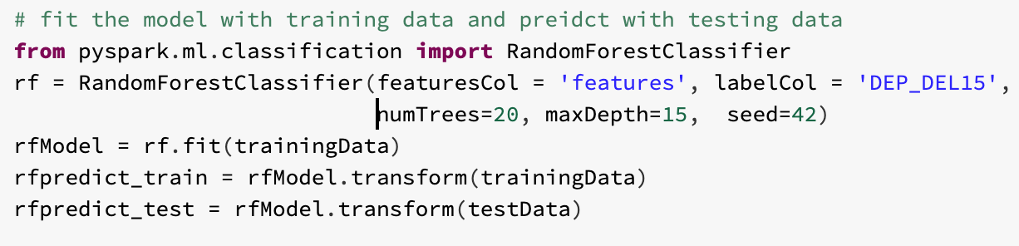
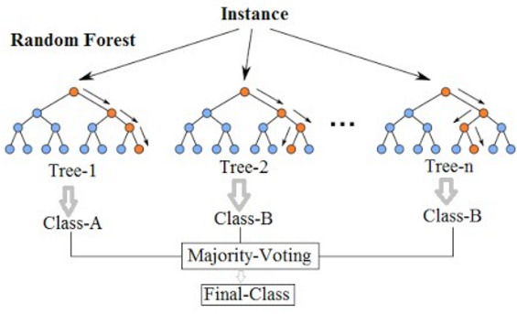
Algorithms - Random Forest
Large number of simple trees, combined at the end of the process.
Output: DEP_DEL15
Features: ['LST_DELAY','outgoing','incoming','’MONTH','DAY_OF_WEEK' ..]
 | Training Data | Test Data
Precision | 0.782 | 0.757
Recall | 0.158 | 0.125
F1 Score | 0.263 | 0.214
Notes:
Continuing our work with Tree based models, we moved to RandomForest. We used the same features as in DecissionTrees, ran the RandomForest model for various configuration and we got improved prediction metrics. Here also we got higher precision but recall is continuing to be low. Prediction metrics for Training and TestData sets are similar and we don’t see any overfitting or under fitting.

Slide 22
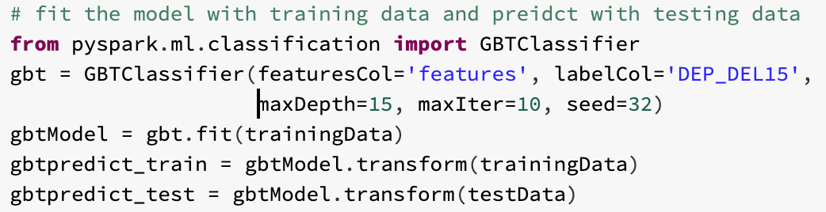
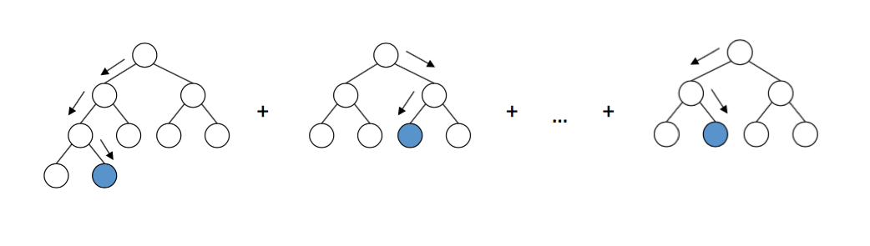
Algorithms - Gradient Boosting Trees (GBT)
Combine decision trees, but start the combining at the beginning
Output: DEP_DEL15
Features: ['LST_DELAY','outgoing','incoming','’MONTH','DAY_OF_WEEK' ..]
 | Training Data | Test Data
Precision | 0.789 | 0.645
Recall | 0.277 | 0.214
F1 Score | 0.410 | 0.322
Notes:
Finally we ran Gradient Boosting Trees with same set of features. On Training Data, we got even higher precision but interestingly prediction metrics on testdata came bit lower indicating some overfitting. We concluded the modeling with Gradient Boosting Trees.

Slide 23
Algorithms Performance Summary
Actual | Predicted
 |  | LogReg |  | DT |  | RF |  | GBT
 |  | Delay | No Delay | Delay | No Delay | Delay | No Delay | Delay | No Delay
 | Delay | 104,206 | 2,961,920 | 534,065 | 2,474,418 | 474,953 | 2,533,530 | 833,324 | 2,175,159
 | No Delay | 88,712 | 13,372,165 | 221,913 | 13,038,834 | 132,561 | 13,128,186 | 222,313 | 13,038,434
Models | LogReg |  | DT |  | RF |  | GBT
Metrics | Training | Test | Training | Test | Training | Test | Training | Test
Precision | 0.54 | 0.539 | 0.706 | 0.709 | 0.782 | 0.757 | 0.789 | 0.645
Recall | 0.034 | 0.039 | 0.178 | 0.154 | 0.158 | 0.125 | 0.277 | 0.215
F1 Score | 0.064 | 0.073 | 0.284 | 0.253 | 0.263 | 0.214 | 0.41 | 0.322
Accuracy | 0.815 | 0.813 | 0.834 | 0.829 | 0.836 | 0.828 | 0.853 | 0.830
Notes:
A quick review of the Algorithm Performance:
Logistic Regression performed poorly. Decision Tree, RandomForest and Gradient Boosting Trees did better in this sequence. Overall we got higher precision but recall continued to be low and it’s mainly because of higher False Negatives. Decision Tree and Random Forest models performed similarly for Training and TestData but Gradient Boosting Tree shows some overfitting.
For getting better model performance, we saw that hyper parameter tuning helped but feature engineering helped with bigger gains.

Slide 24
Performance and Scalability
Learnings
Caching and persisting parquet files
Incremental Joins & Intermediate Tables
Limitation and Challenges
Couldn’t evaluate model performance w.r.t. Time taken.
Scope to get improved model performance if we explore more hyperparameter tuning via grid search.
Notes:
During the project, we have some learning w.r.t. Performance and scalability like:
Caching and persisting data as parquet files is very important especially when working with large sets.
While joining data, instead of a monolithic join, building incremental joins helped us avoid bottlenecks.
Also usage of intermediate tables helped.
We couldn’t evaluate the model performance for scalability because of the shared cluster setup we have. Also we couldn’t try more grid search like techniques for hyperparameter tuning.
Edward will continue with conclusions.

Slide 25
Conclusion
Recommended Algorithm : Random Forest
Predicted
Random Forest
 | Delay | No Delay
Delay | 474,953 | 2,533,530
No Delay | 132,561 | 13,128,186
 | Training | Test
Precision | 0.782 | 0.757
Recall | 0.158 | 0.125
F1 | 0.263 | 0.214
Accuracy | 0.836 | 0.828
Actual
2. ML Learned and Applied:
Spark framework with RDD (distribute and parallelize computation)
Graph algorithm and Pageranks (derived additional features for modeling)
One hot encoding and normalization (optimized the approach)
Logistics regression, decision trees , random forest and gradient boosting trees (achieved good result with advance algorithm)
Notes:
In conclusion, our results show Random Forest model with low FP and FN , and high precision outperform the other models. From business perspective , it would help to reduce the cost and sustain customer satisfaction. Finally, the major technique of Machine Learning we used are
Spark frame and RDD for distribute the dataset across clusters and parallelize the computation
Graph algorithm and pagerank for deriving additional features for training and testing
One hot encoding and normalization for categorical and numerical features,
We explored and implemented different algorithms, optimize them with a reasonable figure to address this business case.
That’s the end of our presentation, and we are open the floor for questions. Thank you !
Supplement info if needed:
Spark framework with RDD which is automatically distributes the datasets contained in RDDs across the clusters and parallelizes the computation of ML algorithms in training, testing and evaluation;
Graph algorithm and large scale graph processing, Pageranks to derive additional features which are used for our modeling; as wells as exploring the results of number of our predefined research questions other than predicting flights delay question;
Used one hot encoding and normalization for categorical and numerical features to allow our models training and testing in an more efficient and optimized approach;
In terms of algorithms, we have implemented logistics regression, linear regression and decision trees as well as random forest and gradient boosting trees for our models evaluation. In particular, trees algorithm are expected to achieve a good result in a more parallelize and scalable manners though we are not able to compare amongst all algorithms timing due to the shared infrastructure resources

Slide 26

Thank You!
Q&A
Thank You

Slide 27
Reference
Bureau of Transportation Statistics https://www.transtats.bts.gov/DL_SelectFields.asp?Table_ID=236 https://www.bts.gov/topics/airlines-and-airports/understanding-reporting-causes-flight-delays-and-cancellations
Matching station codes to airports: http://dss.ucar.edu/datasets/ds353.4/inventories/station-list.html https://www.world-airport-codes.com/
UC Berkeley School of Information, MIDS W261 - Fall 2020, all course materials
Open flights data http://openflights.org
“Machine Learning Crash Course” https://developers.google.com/machine-learning/crash-course
“Labs Graph Theory -Small World Network” http://web.math.princeton.edu/math_alive/5/Lab1/Networks2.html

